Slide 1
Beyond Library’s Catalog: Providing Metadata for Magario Family Diary Collection
Committee on Technical Processing
Council on East Asian Libraries
Annual Meeting
March 22, 2018
Mieko Mazza
Stanford University

Slide 2
Presentation outline
Background
General overview
Method and workflow
Challenges and issues
Possible applications

Slide 3
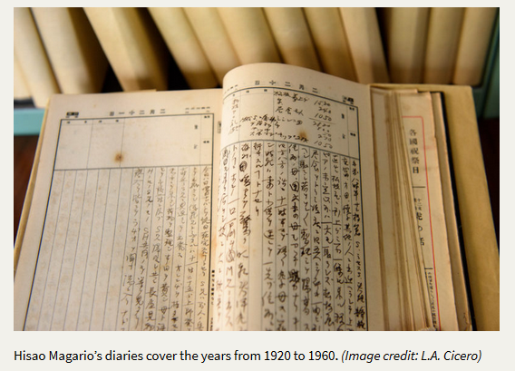
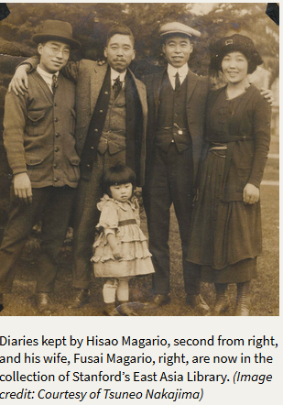
Collection background: Magario family diaries, 1920-1972, three linear feet

Slide 4
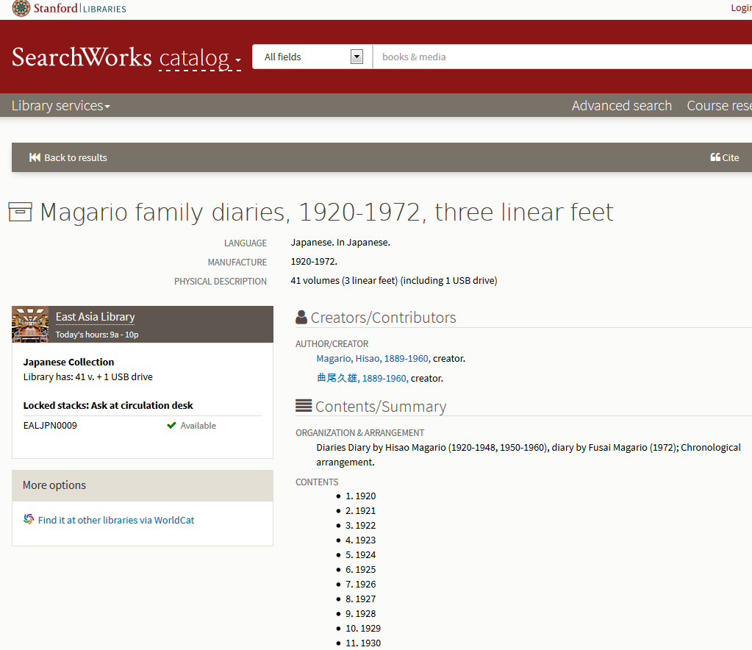

Slide 5
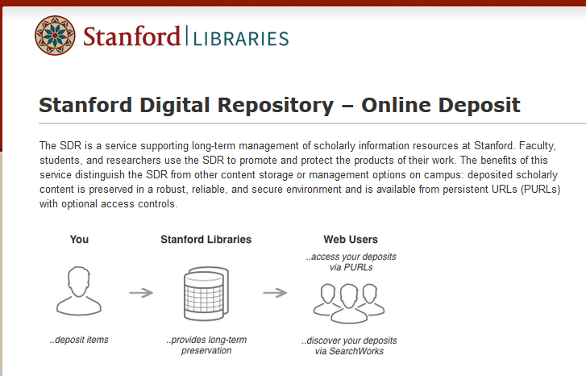

Slide 6
Method and workflow
Collaboration with Digital Library Systems and Services (DLSS)
Add to Stanford Digital Repository (SDR)
MODS Entry with Replayable Spreadsheet
Pilot project (1920 and 1924), May-October 2017

Slide 7
Issues and challenges
OCR not possible
Pilot project modified from partial to full transcription (July 2017-)
Assigning subject keywords
Assigning personal, corporate, geographic name keywords

Slide 8
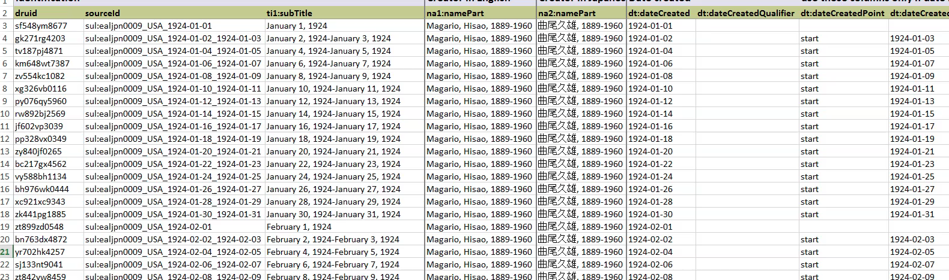

Slide 9
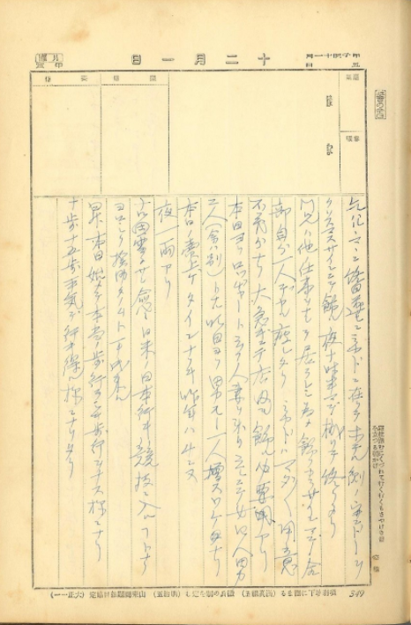

Slide 10
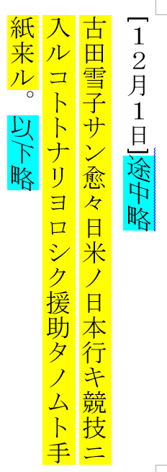
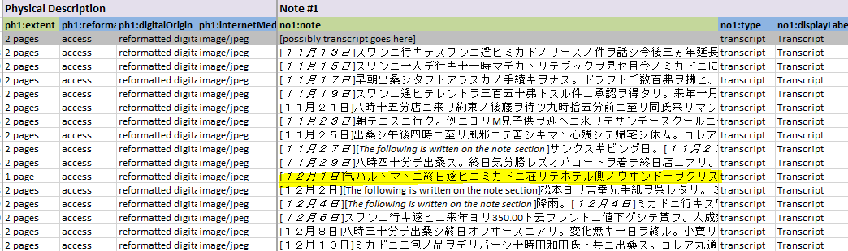

Slide 11
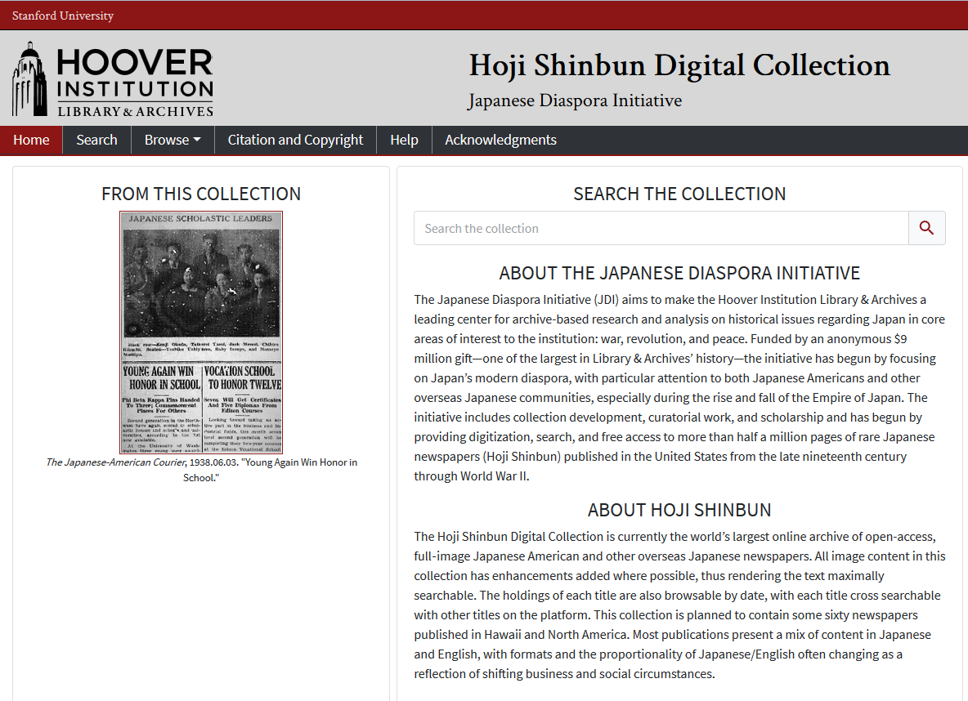

Slide 12
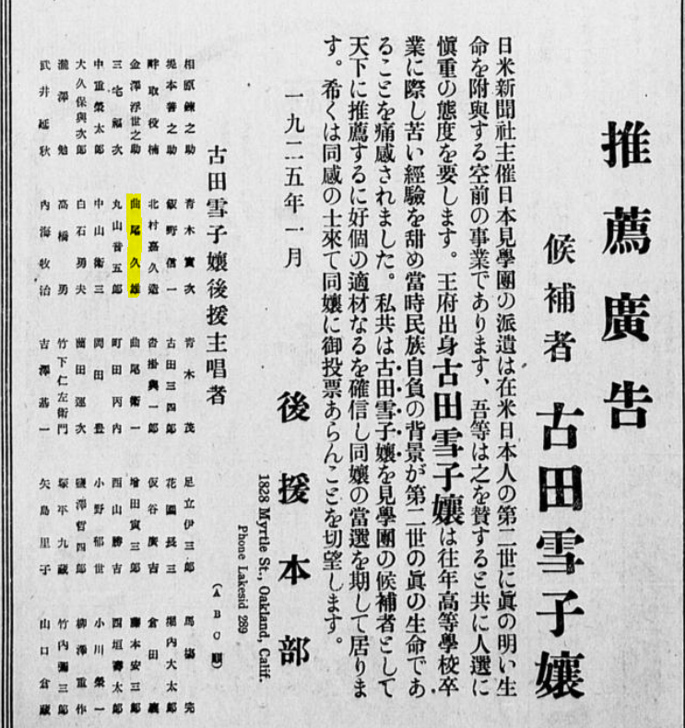

Slide 13
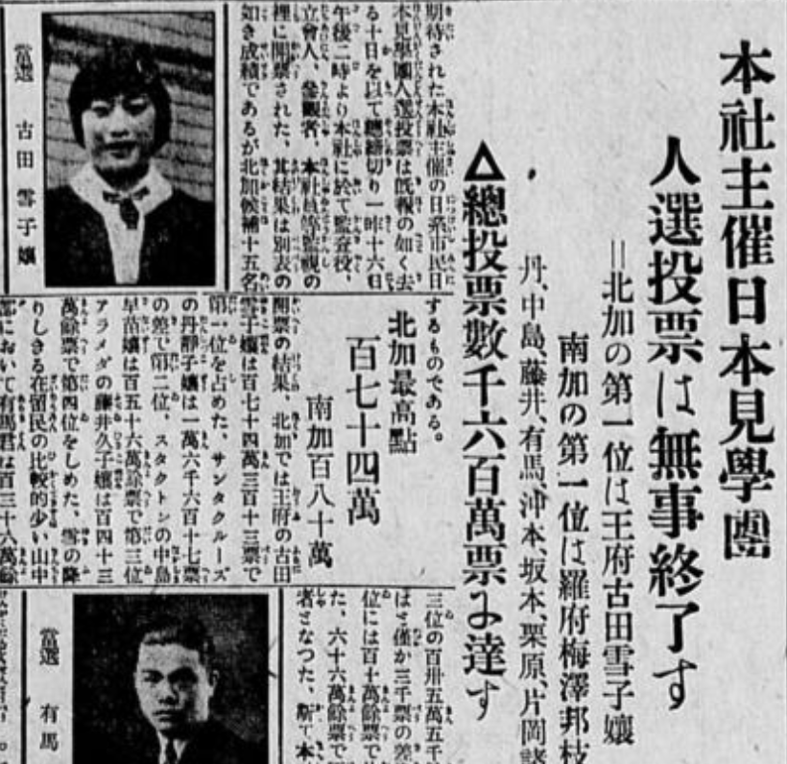

Slide 14
Digital Showcases for Stanford
Spotlight Exhibit
“… users can quickly build their own online exhibits featuring digital content stored within and outside of the Stanford Digital Repository without having to develop their own project interface or use a proprietary system.”

Slide 15
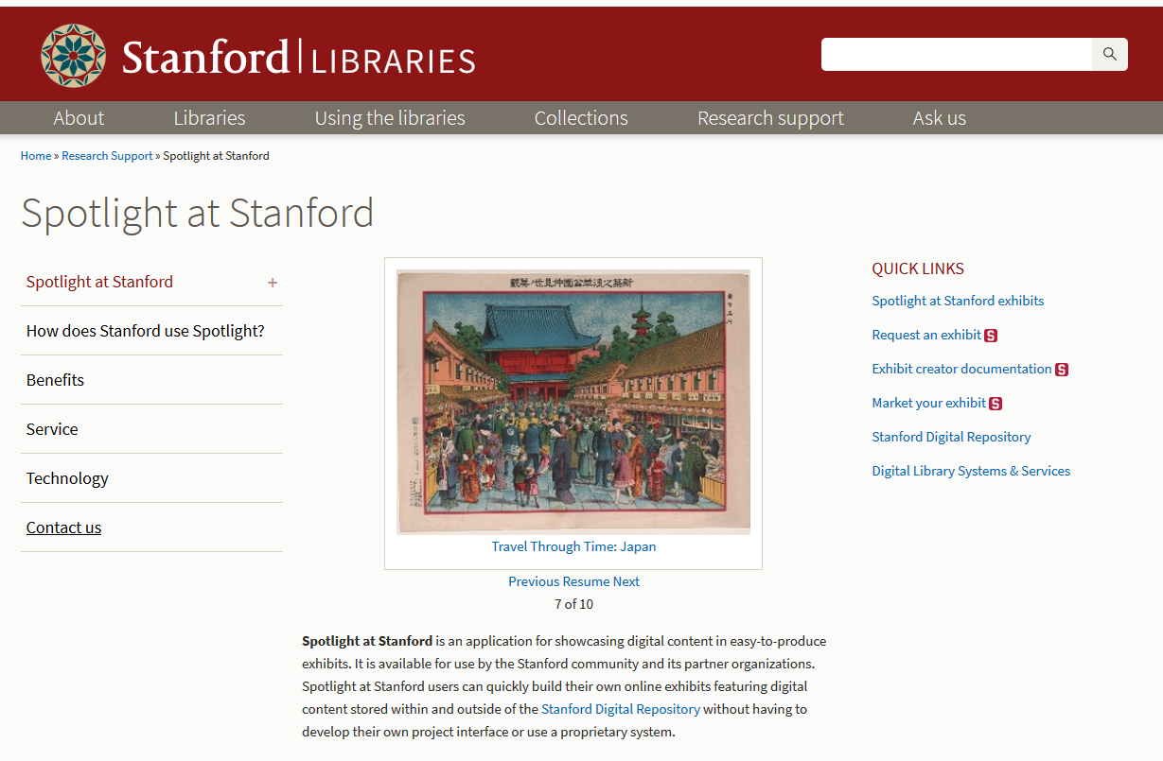

Slide 16
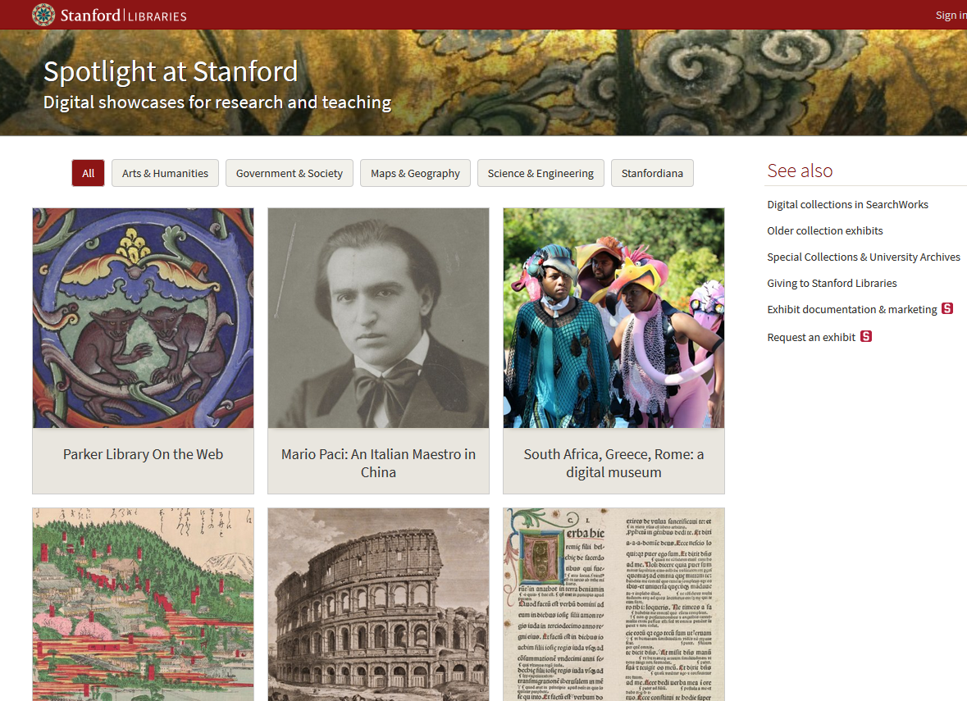

Slide 17
Crowdsourcing of manuscript materials
Stanford University Archives launches transcription crowdsourcing project (Oct. 2007-)
From the Page
IIIF
Spotlight exhibit

Slide 18
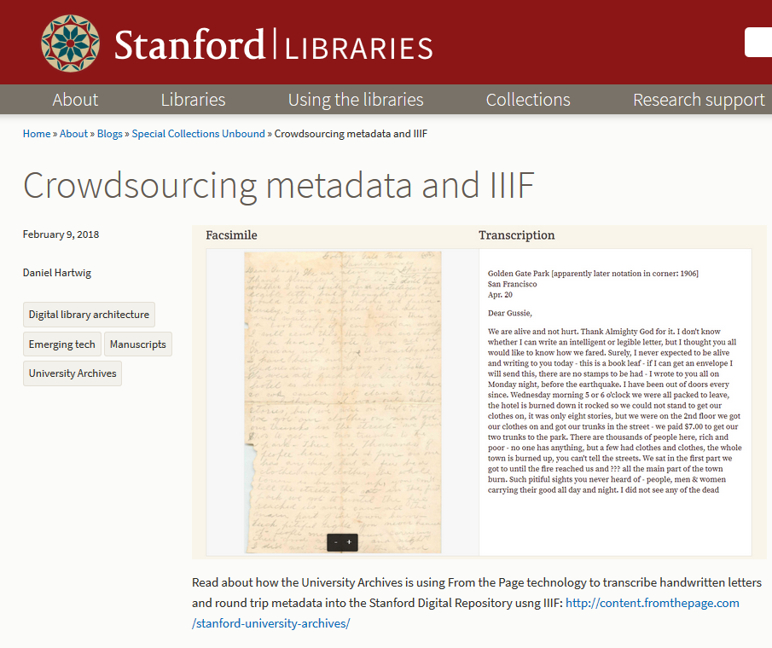

Slide 19
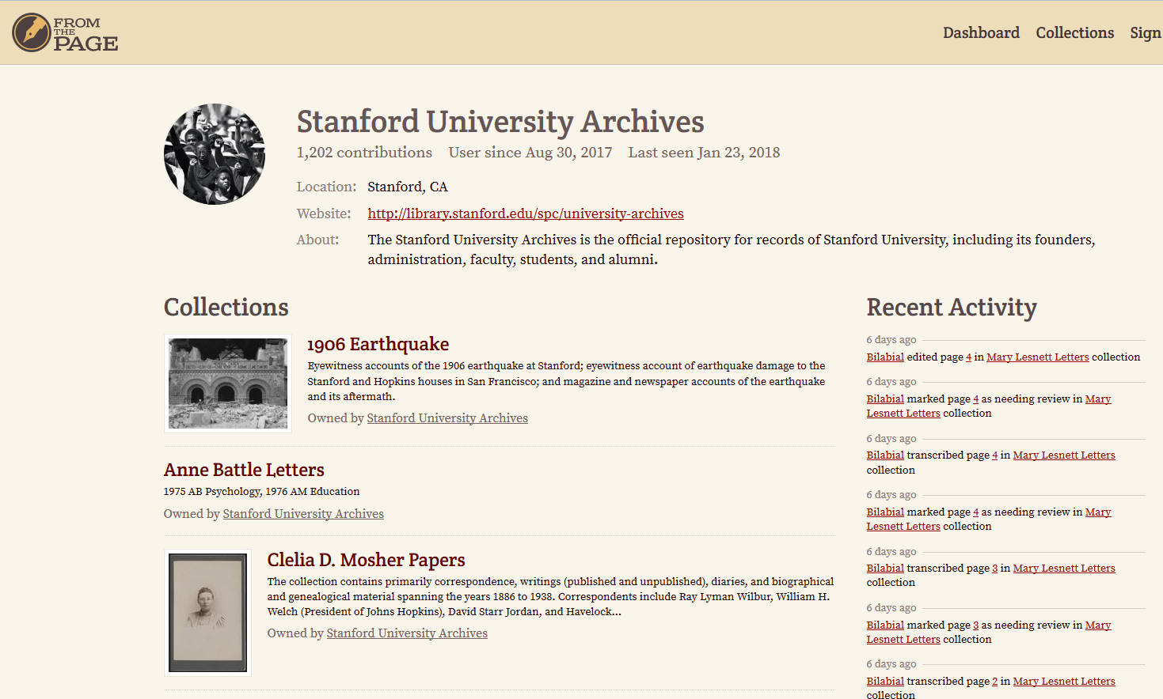


Slide 20
Reference materials
Stanford News
https://news.stanford.edu/2017/05/04/japanese-immigrants-diaries-display/
KQED Arts
Myrow, Rachael. “Stanford Receives Cache of Rare Japanese Immigrant Diaries | KQED Arts.” KQED, 11 May 2017, www.kqed.org/arts/13194951/stanford-japanese-immigrant-diaries-hisao-magario.T
The Hoji Shinbun Digital Collection (The Japanese Diaspora Initiative (JDI), Hoover Institution Library & Archives, Stanford University)
https://hojishinbun.hoover.org/
From the Page
https://fromthepage.com/
Special Collections Unbound blog
Hartwig, Daniel. “Crowdsourcing Metadata and IIIF.” Special Collections Unbound , University Archives , 9 Feb. 2018, library.stanford.edu/blogs/special-collections-unbound/2018/02/crowdsourcing-metadata-and-iiif.

Slide 21
Thank You
Mieko Mazza
Japanese Technical Services Librarian
East Asia Library
Stanford University Libraries
Stanford, CA 94305
Email: miekom@stanford.edu

